Slide 1




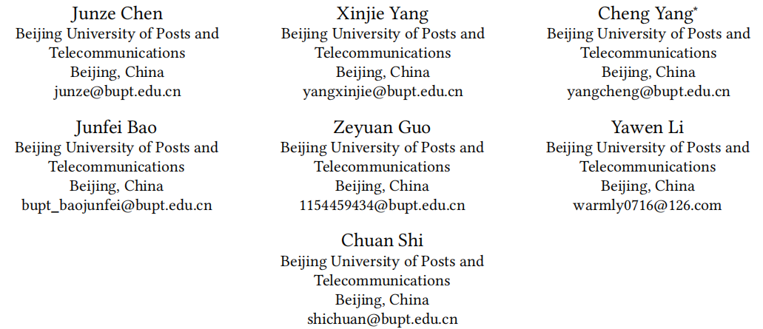





ATAI
Advanced Technique of Artificial Intelligence
ATAI
ChongqingUniversity _{AdvancedTechniqueof}
of Technology Artificial Intelligence
Chongqing University of Technology
Chongqing University ^{ATAI}
_{of Technology} Advanced Techniqueof
Artificial Intelligence
Chongqing University of Technology
Chongqing University of Technology
CORONA: A Coarse-to-Fine Framework for Graph-based Recommendation with Large Language Models
Code: https://github.com/BUPT-GAMMA/CORONA
—— SIGIR ’25
Reported by Hao Liu
1

Slide 2
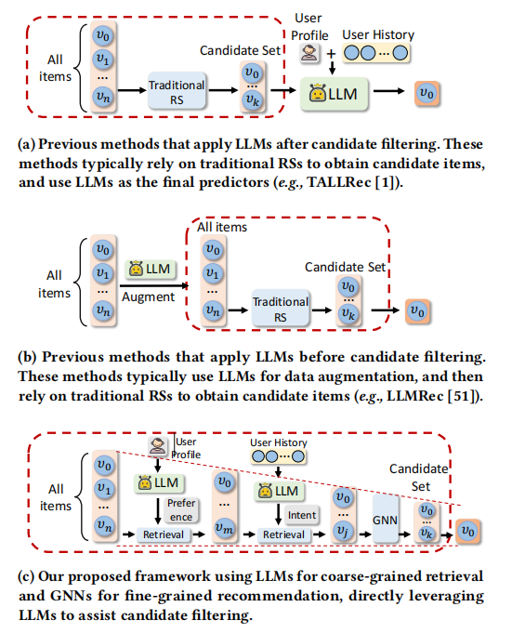
ATAI
Advanced Technique of
Artificial Intelligence
ATAI
ChongqingUniversity _{AdvancedTechniqueof}
of Technology Artificial Intelligence
Chongqing University of Technology
Motivation
a) is limited by the context length of LLMs and the quality of the candidate set
b) only uses them as a means of data augmentation, without involving LLMs in the core filtering process
Both lines of work failed to explore LLMs’ capabilities during the filtering process of candidate items, which may lead to suboptimal performance

Slide 3
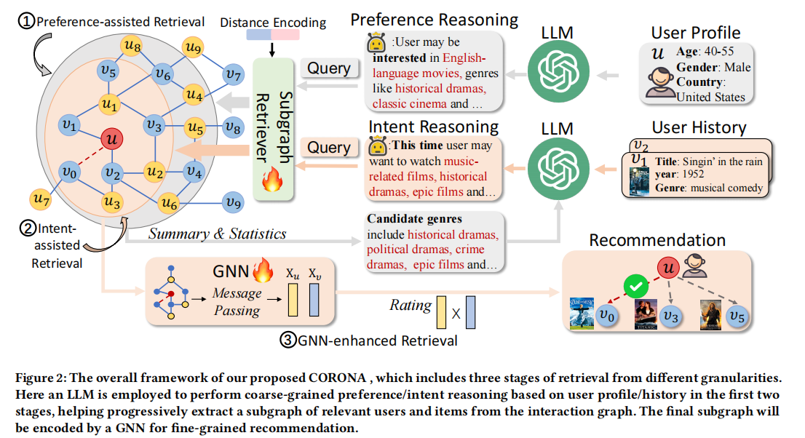
ATAI
Advanced Technique of
Artificial Intelligence
ATAI
ChongqingUniversity _{AdvancedTechniqueof}
of Technology Artificial Intelligence
Chongqing University of Technology
Overview

Slide 4
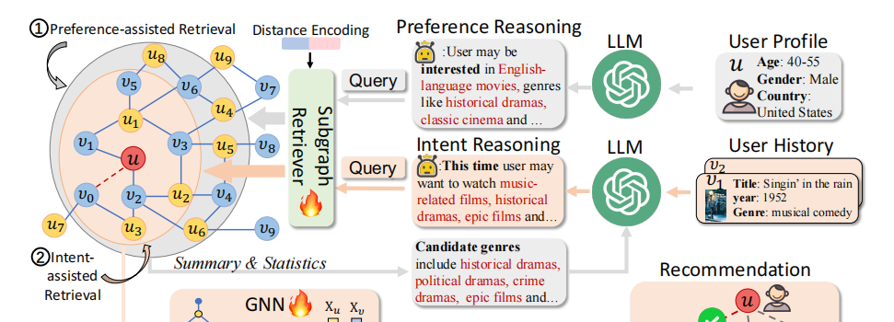
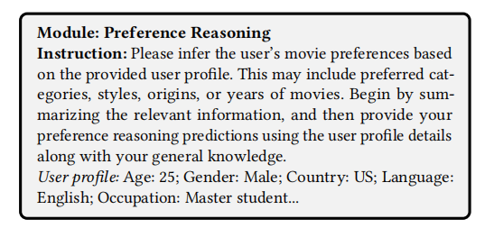
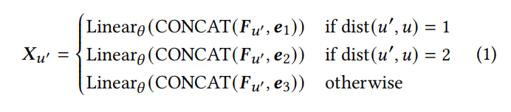
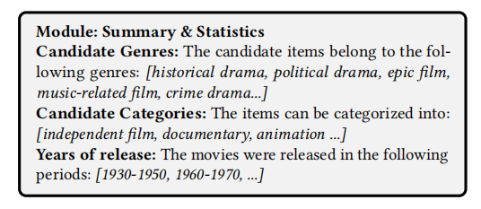




ATAI
Advanced Technique of
Artificial Intelligence
ATAI
ChongqingUniversity _{AdvancedTechniqueof}
of Technology Artificial Intelligence
Chongqing University of Technology
Method
$$Q_{1}={LLM}_{PR}(P_{u})$$
$$E_{Q_{1}}=Encoder(Q_{1})$$

Slide 5
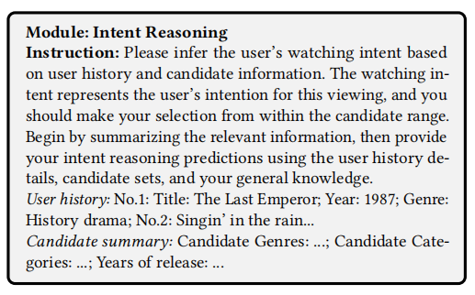
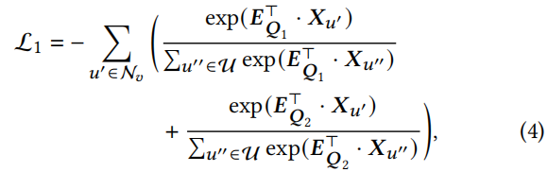



ATAI
Advanced Technique of
Artificial Intelligence
ATAI
ChongqingUniversity _{AdvancedTechniqueof}
of Technology Artificial Intelligence
Chongqing University of Technology
Method
$$Q_{2}={LLM}_{IR}(Summary(T_{{V_{1}}^{′}}){,T}_{L_{u}})$$
$$E_{Q_{2}}=Encoder(Q_{2})$$

Slide 6
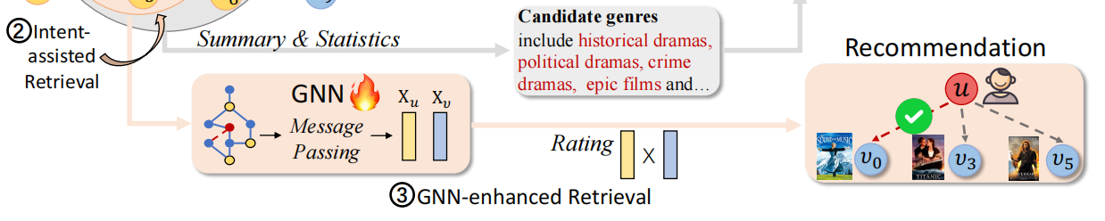

ATAI
Advanced Technique of
Artificial Intelligence
ATAI
ChongqingUniversity _{AdvancedTechniqueof}
of Technology Artificial Intelligence
Chongqing University of Technology
Method

Slide 7
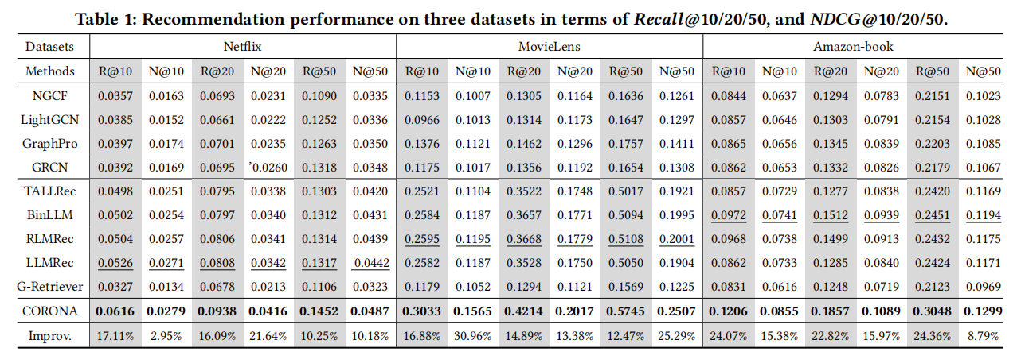
ATAI
Advanced Technique of
Artificial Intelligence
ATAI
ChongqingUniversity _{AdvancedTechniqueof}
of Technology Artificial Intelligence
Chongqing University of Technology
Experiments

Slide 8
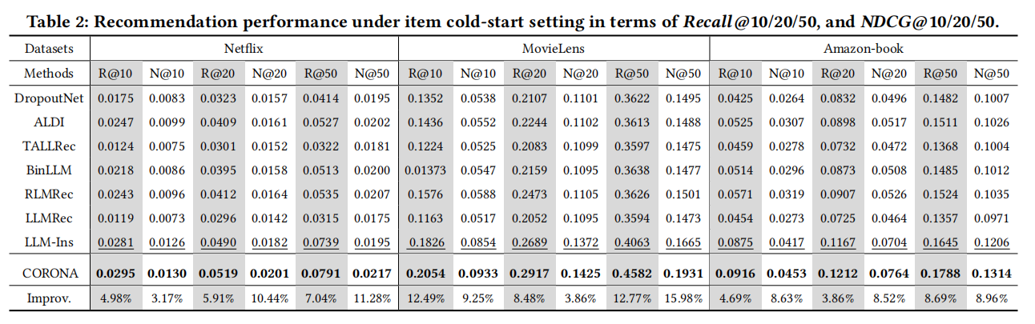
ATAI
Advanced Technique of
Artificial Intelligence
ATAI
ChongqingUniversity _{AdvancedTechniqueof}
of Technology Artificial Intelligence
Chongqing University of Technology
Experiments

Slide 9
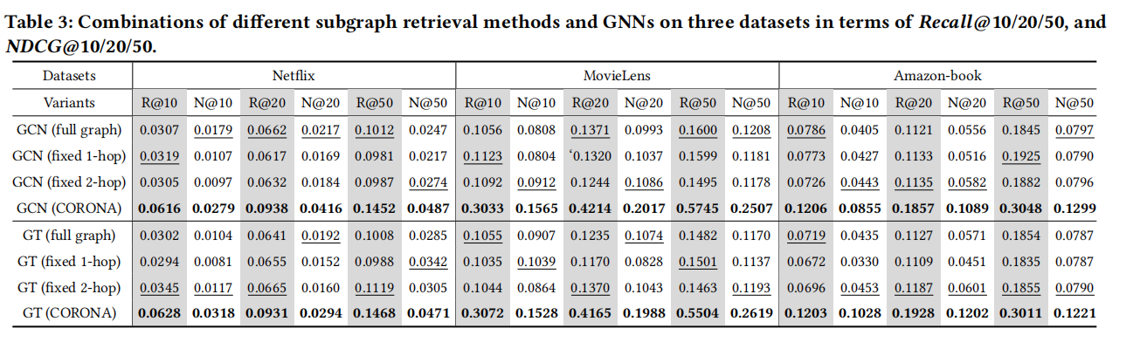
ATAI
Advanced Technique of
Artificial Intelligence
ATAI
ChongqingUniversity _{AdvancedTechniqueof}
of Technology Artificial Intelligence
Chongqing University of Technology
Experiments

Slide 10
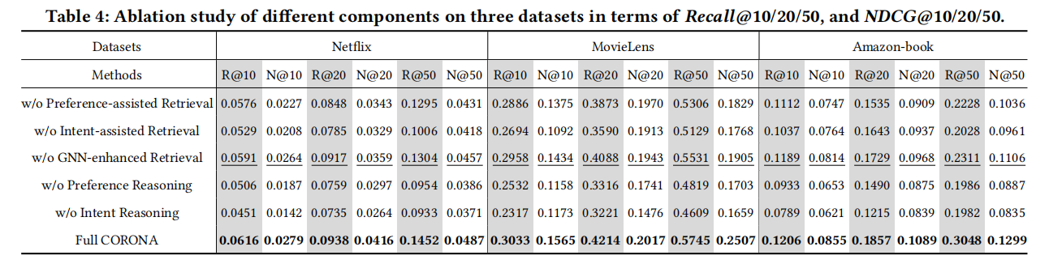
ATAI
Advanced Technique of
Artificial Intelligence
ATAI
ChongqingUniversity _{AdvancedTechniqueof}
of Technology Artificial Intelligence
Chongqing University of Technology
Experiments

Slide 11
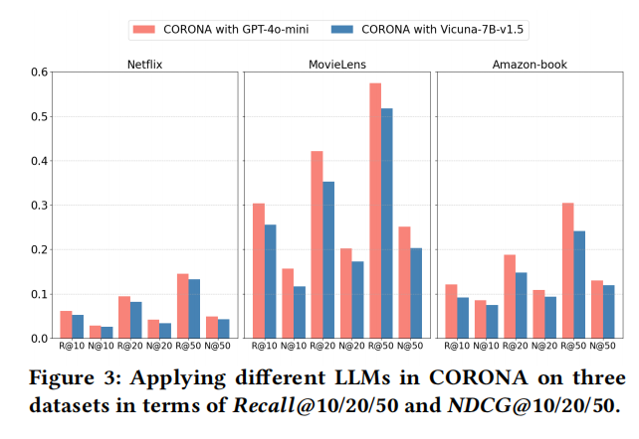
ATAI
Advanced Technique of
Artificial Intelligence
ATAI
ChongqingUniversity _{AdvancedTechniqueof}
of Technology Artificial Intelligence
Chongqing University of Technology
Experiments

Slide 12
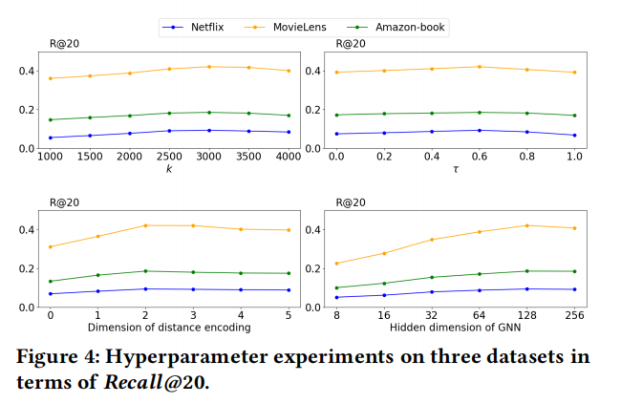
ATAI
Advanced Technique of
Artificial Intelligence
ATAI
ChongqingUniversity _{AdvancedTechniqueof}
of Technology Artificial Intelligence
Chongqing University of Technology
Experiments

Slide 13
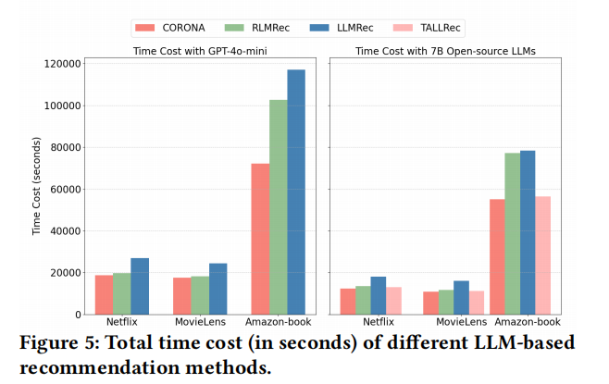
ATAI
Advanced Technique of
Artificial Intelligence
ATAI
ChongqingUniversity _{AdvancedTechniqueof}
of Technology Artificial Intelligence
Chongqing University of Technology
Experiments

Slide 14
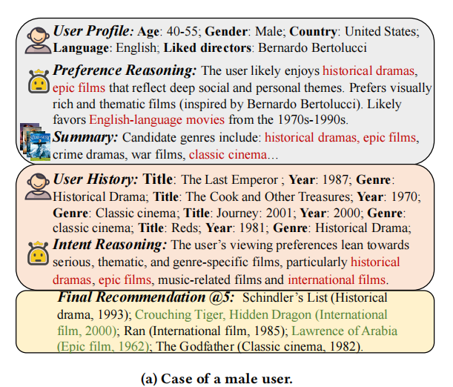
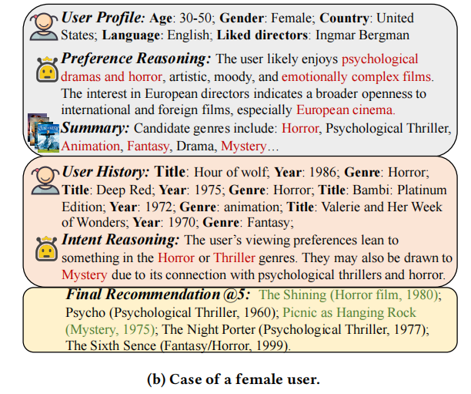
ATAI
Advanced Technique of
Artificial Intelligence
ATAI
ChongqingUniversity _{AdvancedTechniqueof}
of Technology Artificial Intelligence
Chongqing University of Technology
Experiments

Slide 15


ATAI
Advanced Technique of
Artificial Intelligence
ATAI
ChongqingUniversity _{AdvancedTechniqueof}
of Technology Artificial Intelligence
Chongqing University of Technology
Thanks!

